Slide 1

WALMART RECRUITING :
TRIP TYPE CLASSIFICATION
MADE BY – AISHWARYS KAMBOJ
UNIV ROLL NO. - 2017451

Slide 2

SHOW DIAGRAM
INTRODUCTION
STATEMENT PROBLEM
TOOLS AND SOFTWARE USED
METHODOLOGY
DIFFICULTIES FACED
FURTHER IMPROVEMENT
LIMITATIONS
FUTURE PLAN

Slide 3
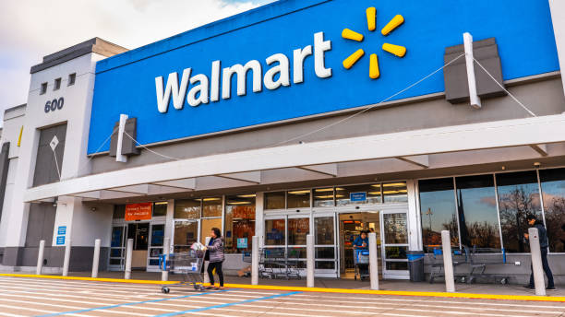
INTRODUCTION
Walmart is an American worldwide organization that works a chain of hypermarkets, markdown retail chains and supermarkets from the United States.
Confronted with the opposition from web based business stages, customary retailing undertakings have presented state of the art innovations like Machine Learning, the Internet of Things, and Artificial Intelligence to enhance disconnected situations. Walmart is at the wilderness and is as of now adopting benefits of strategies, including social methodologies, psychographic approaches, segment draws near, and geographic methodologies in target market choice and market division.
The reason for this venture is to assist Walmart with bettering section clients to customize the help and publicizing. In light of the things bought by clients, Walmart has arranged stumbles into 38 kinds and anticipates that information specialists and aficionados should reproduce the grouping with less highlights. We are eager to stand up to the test.

Slide 4
STATEMENT PROBLEM
Walmart Recruiting Trip Type Classification is an undertaking where we oversee information of pre cherished merchandise by the clients gathered by Walmart in various states and handling the information and come by the most positive result helping the client buying experience by utilizing choice tree order.

Slide 5
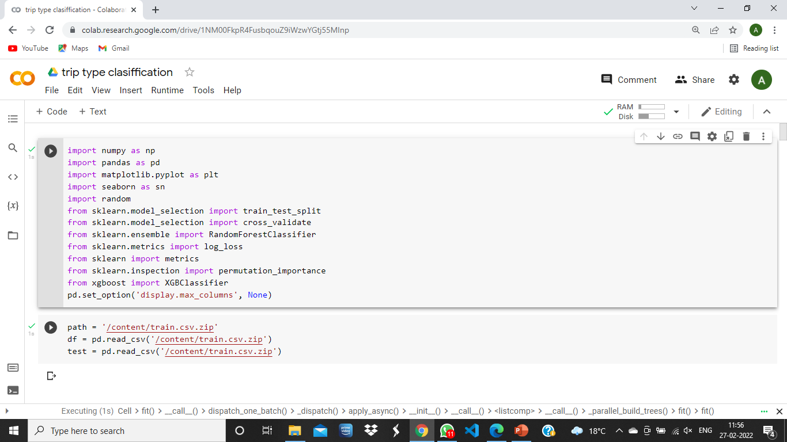
TOOLS AND SOFTWARE
SOFTWARE USED-
GOOGLE COLAB
LIBRARIES USED

Slide 6
METHODOLOGY
RANDOM FOREST CLASSIFIER- A random forest is a meta estimator that fits a number of decision tree classifiers on various sub-samples of the dataset and uses averaging to improve the predictive accuracy and control over-fitting. It uses multiple decision trees .
XGBOOST CLASSIFIER- XGBoost is a decision-tree-based ensemble Machine Learning algorithm that uses a gradient boosting framework.The algorithm differentiates itself in the following ways: A wide range of applications: Can be used to solve regression, classification, ranking, and user-defined prediction problems.
LINK FOR THE CODE : https://colab.research.google.com/drive/1NM00FkpR4FusbqouZ9iWzwYGtj55MInp?usp=sharing

Slide 7

DIFFICULTIES FACED
Each observation represents a specific item instead of all the purchasing items on a trip
Multi-class Imbalance
Non-descriptive data

Slide 8

FURTHER IMPROVEMENT
Feature Engineering
(2) Collect More Data
Walmart only provides us with purchase records of customers. If more information like demographic data is provided, the models will achieve a higher accuracy.

Slide 9
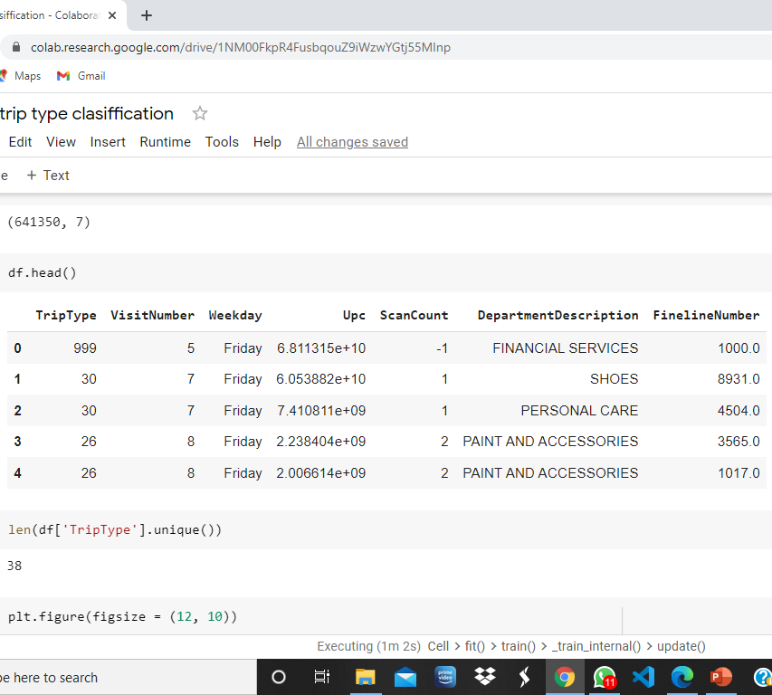
LIMITATIONS
Walmart only provides us with purchase records of customers. If more information like demographic data is provided, the models will achieve a higher accuracy.

Slide 10

FUTURE PLAN
To reduce the log loss , so as to receive more accuracy.
To add more graphs and charts .

